Slide 1

OOSP (Open Source Space Projects) A Marketplace for Open Science Projects
Mathew Pellarin – 4th year Computer Science Student
Abbie Dewhirst – 4th year Computer Science Student
University of Windsor

Slide 2
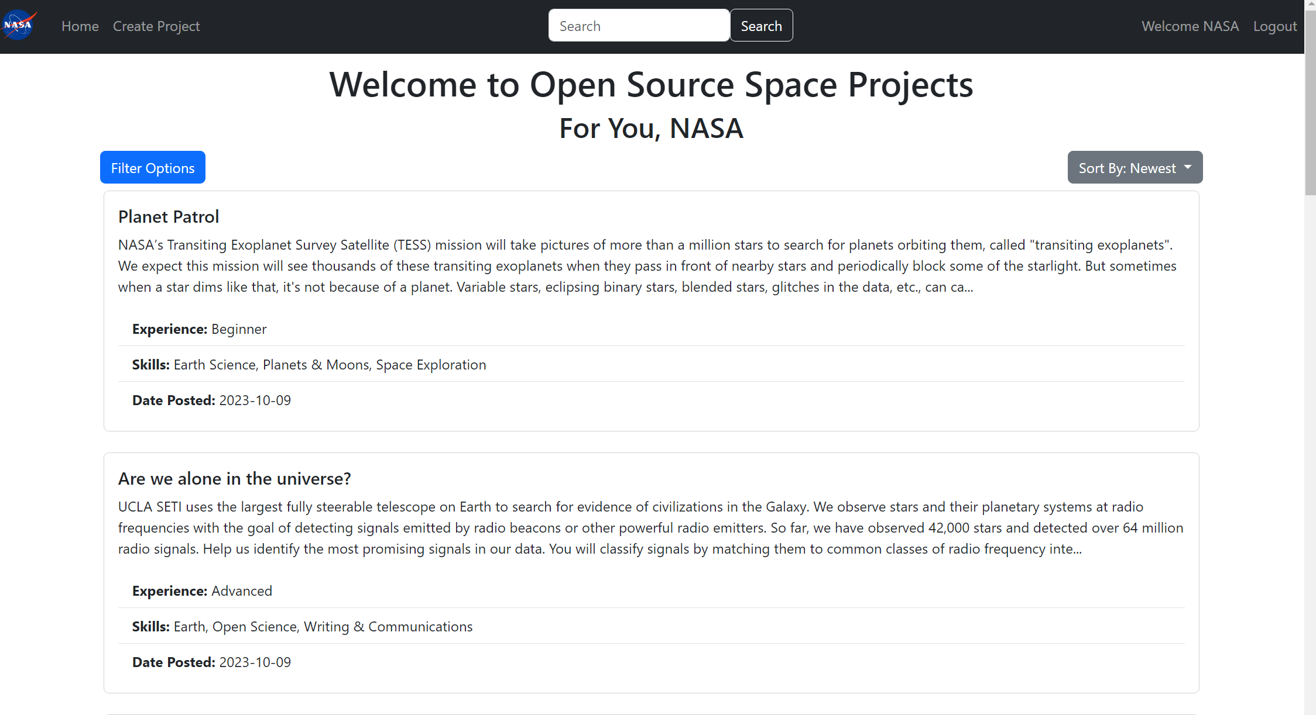
Our challenge
A Marketplace for Open Science Projects, brough fourth the issue of individuals having to search multiple sites to find projects.
Our solution?
Our solution is a one stop shop website where anyone can post their open projects, and searching individuals can easily search and apply.

Slide 3
What inspired us to select this challenge?
Since we are both 4th year students, we are currently searching for post-grad jobs.
We have found that finding a job is hard. Not every employer post on the same job site and searching can take hours.
Finding a project for researchers must bring the same struggles.
Why can’t we have a centralized website, where everyone can post their projects when searching for help?
Thus became OSSP (Open Source Space Projects)

Slide 4
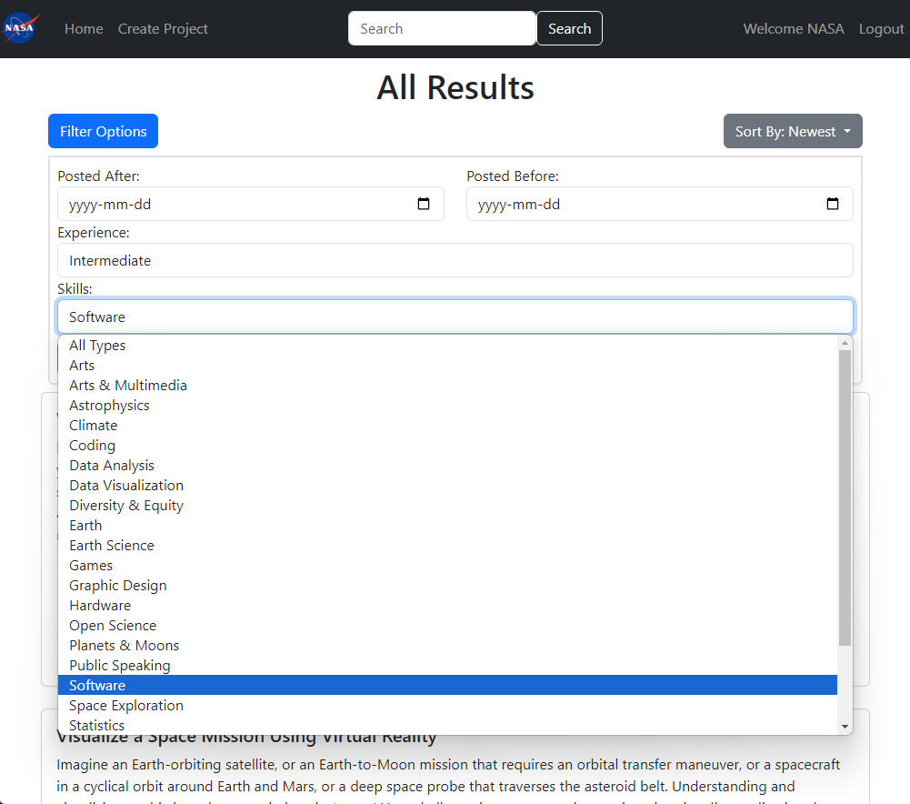
What makes our project stand out?
Our project makes it easy to filter by experience level, and skill set. Only looking for projects in software? We have a filter for that
Are you looking for a project starting next year? We can filter for that as well! Just change the “Posted After” and “Posted Before” dates!

Slide 5
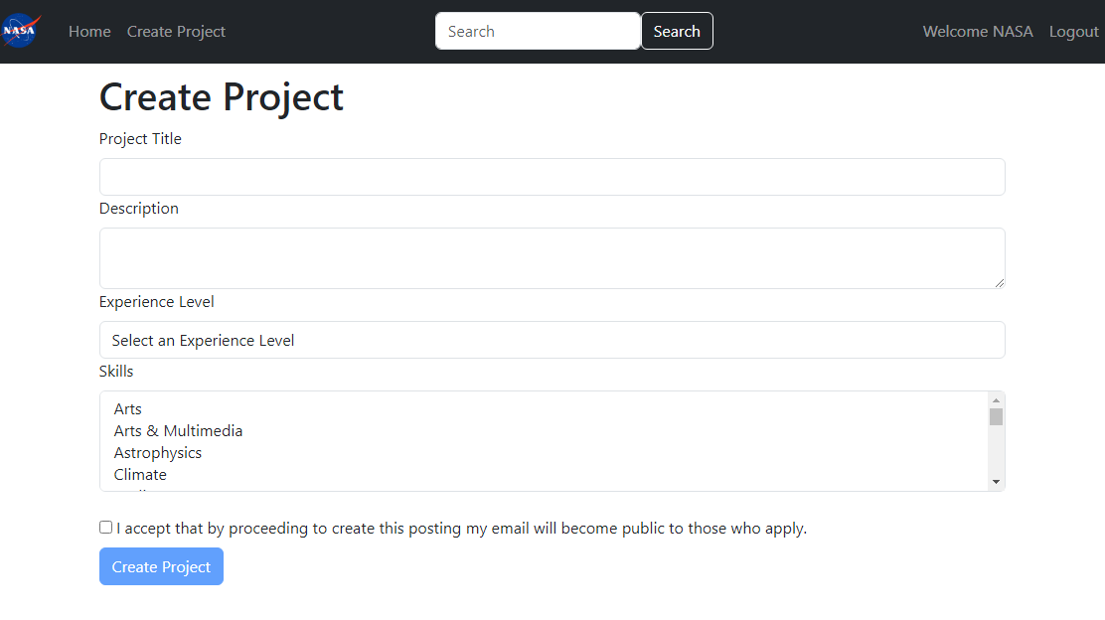
Easily post your project to find help!
Using OSSP, you can easily create a project posting with a title, description, experience level, and skills that are used.
These filters help you find the help you are looking for!
Users must accept that creating a post shares their email, as searching individuals contact project managers by email

Slide 6
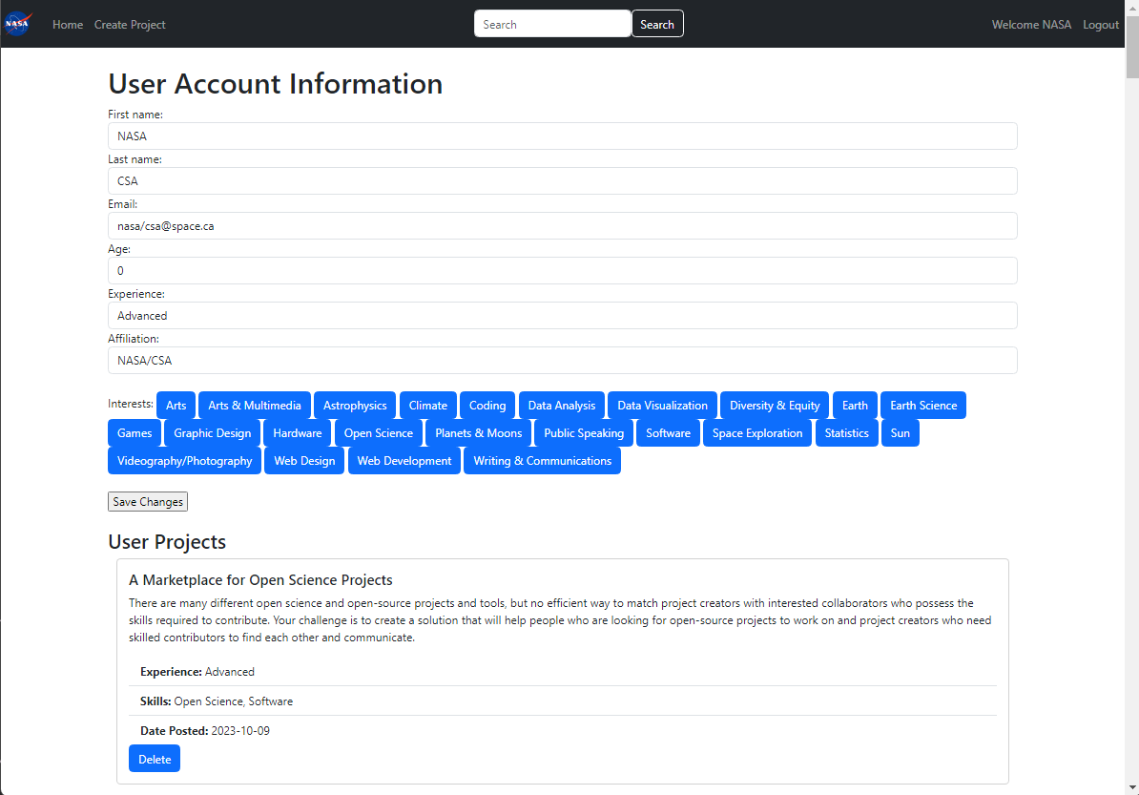
Easily see your account info and projects posted!
From your user account, you can see your personal information, as well as any projects you’ve posted!
Have you found your dream team? Delete the project from our database so users know the team is full!

Slide 7
The future of Open Source Space Projects
The future of Open Source Space Projects is very bright. As we gain users, we can expand info such as skills, and even put more details such as links to project website and more!
Want to experience our website for yourself?
Link: nasa.matp101.com
Email: nasa/csa@space.ca
Password: 1234567
(Note: You do not have to create a “real” account to try out our website! Any random email and password will work)

